Slide 1
ENOVIA V6 Fundamentals
Strategy/Concept/Architecture Overview
Notes:
This is the “Presentation title” page. Type the title of your presentation in the "Presentation title” field.
Cette page est la page de titre d’une présentation . Saisissez votre titre dans la zone « Titre de la présentation ».

Slide 2
Learning Objectives
At the end of this module, you should be able to:
Describe PLM 2.0 and its influence on ENOVIA V6 Design and Architecture
Describe the 6 Values of the V6 Platform
Describe key benefits of V6

Slide 3
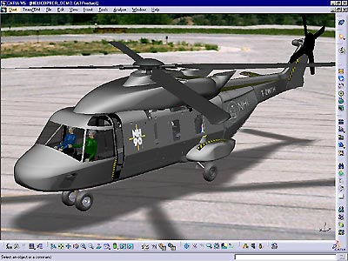

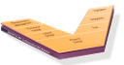


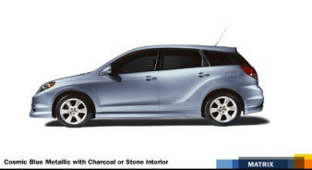
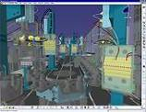
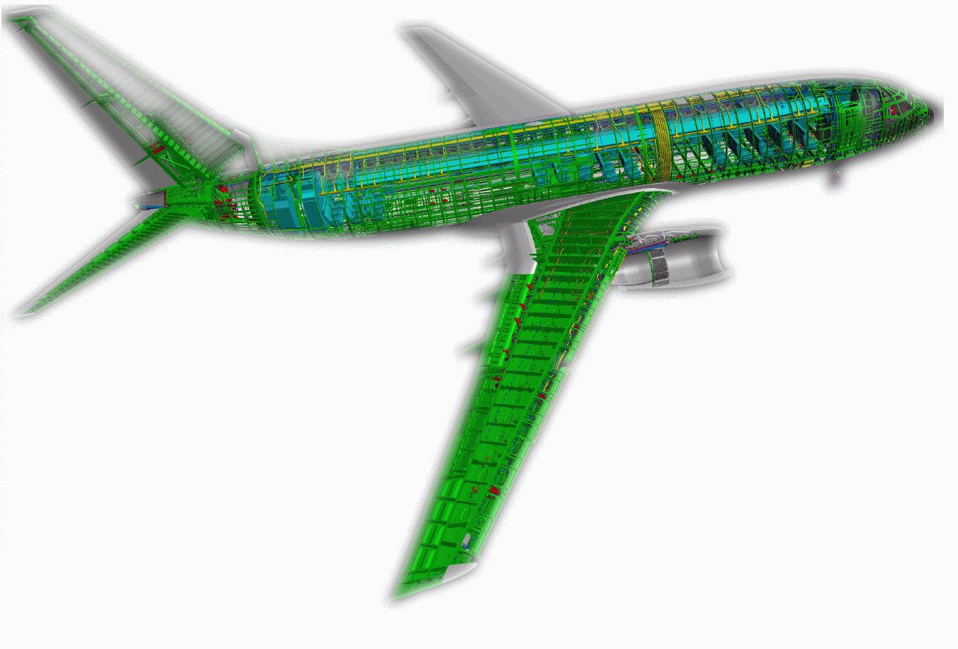
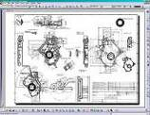
DS Strategy: PLM2.0, the PLM Online for All “Online environment for virtual experience in 3D from anywhere”
6
4
5
Lifelike
Experience
^{Using the 3D Media for:}
Realistic
Simulation
Social Design
Collaborative Business Process
Global Collaborative Innovation
Intellectual Property for PLM (Modeling & Simulation)
3
2
Product Life Cycle Management
1
Digital Mock-Up
^{PLM 2.0}
^{All Users}
^{Users’ Interactions}
^{Generate IP}
^{Experience in 3D}
^{Online}
3D
^{PLM 1.0}
2D
Progress
of Virtual Knowledge
^{3D}
1981
1994
2000
2005
2011
Notes:
Our strategy really demonstrates thought leadership and action towards building PLM2.0, the PLM online for all.
Let’s look at this step chart here.
First, we were never in 2D but always in 3D. And 3D is really at the heart of every step of our strategy. We went from 3D to digital mock up to product lifecycle management which aggregates all the engineering functions necessary for product development, product engineering and manufacturing.
We then had a major step with “collaborative business processes” which associates to the PLM system all the business functions of the enterprise.
Next we are associating the end-consumer to that system and that requires a model compliant with reality and of course a lifelike experience.
Now the integral part of this whole curve is PLM2.0, the PLM online for all. We define it as “an online environment for virtual experience in 3D where all user’s interactions generate intellectual property”.
Looking right below PLM 2.0, you see the essentials of that definition:
PLM2.0 is for All users
It is about Users’ interactions that is, it is about harnessing the intelligence of online communities. Let me give you an example: when you are in a CATIA environment you will then be able to quickly connect with a co-worker, that is first of all, find that co-worker, then connect, share with him product related information and ideas, collaborate and act, create as a group
Those Users interactions generate Intellectual Property, that is knowledge andproduct-related information from idea to product experience
PLM2.0 is also about the experience in 3D, that is, building a model which matches real life
And then finally, PLM 2.0 is about being online
Let me insist on “For All” and “Online” since PLM 2.0 is PLM Online for All

Slide 4




PLM 2.0 on V6 Platform
Key Values
Global collaborative innovation
People
Experience
Lifelike experience
Single PLM platform for IP management
Produce
Online creation and collaboration
Experience
Ready to use PLM business processes
Collaborate
Lower cost of ownership
Simulate
Design
Notes:
V6라는 개념은 PTC, SIMENS, DS가 동일하다.
단지 시작하는 단계가 조금씩 다를 뿐
2. Lifelike Experience 항목은 타사에 비해 좀 다르다.
4

Slide 5



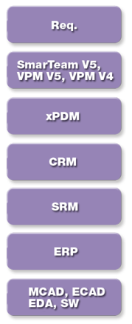
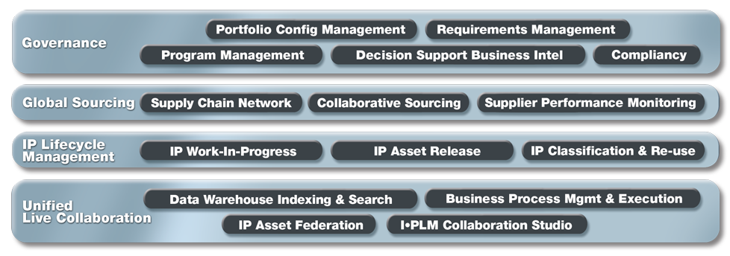
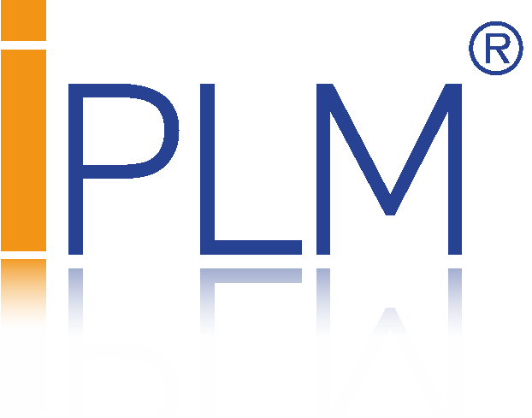



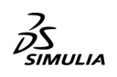

PLM 2.0 – ENOVIA V6 Footprint
Imagine | Play
Lifelike Experience
Collaborative Innovation
Virtual Design
Realistic Simulation
Digital Manufacturing & Production
Systems
Manufacturing Planning
Shape
Compliance
Plant & Resources Eng.
Mechanical
Multiphysics Digital Lab
Program & Control Eng.
Equipments
Open Scientific Platform
Production Execution
Notes:
5
5
Let’s zoom into the V6 Solution Referential:
At the modeling & simulation level we have CATIA for Virtual Design, SIMULIA for Virtual Testing & Compliancy & DELMIA for Virtual Manufacturing & Production.
ENOVIA is the fundamental component for Global Collaborative Innovation for PLM.
Four main domains:
Live Collaboration Platform
IP Lifecycle Management
Global Sourcing
Governance
Deliver integration with large number of applications and enterprise application

Slide 6
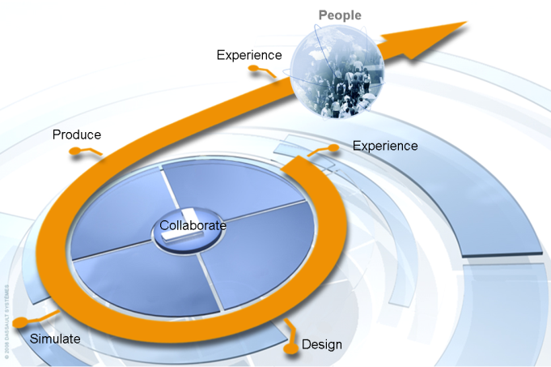
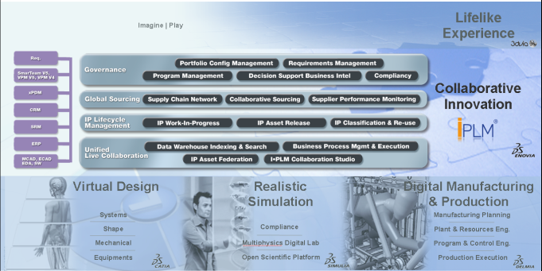
V6 Fundamentals
To accelerate innovation spiral, all data import, export & conversion should be eliminated
Share design without local data duplication
Share product structure between design, simulation and manufacturing
ENOVIA V6 provides one single Architecture
To enable efficient cross-discipline collaboration, between all applications
Same Configuration Management across all disciplines
Program Management covering all activities of a projects
ENOVIA V6 relies on one single Data Model

Slide 7
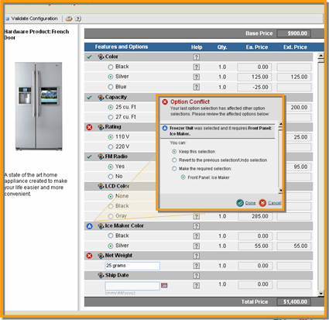
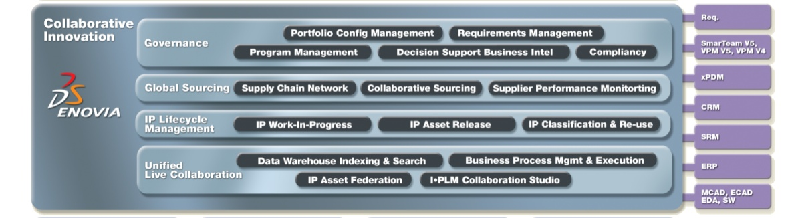
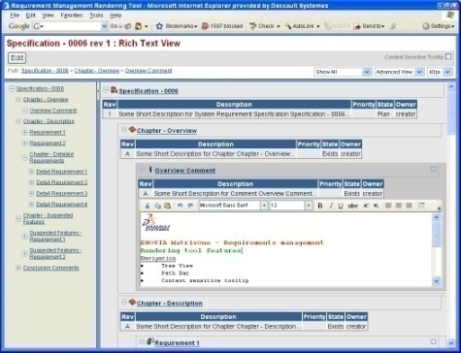
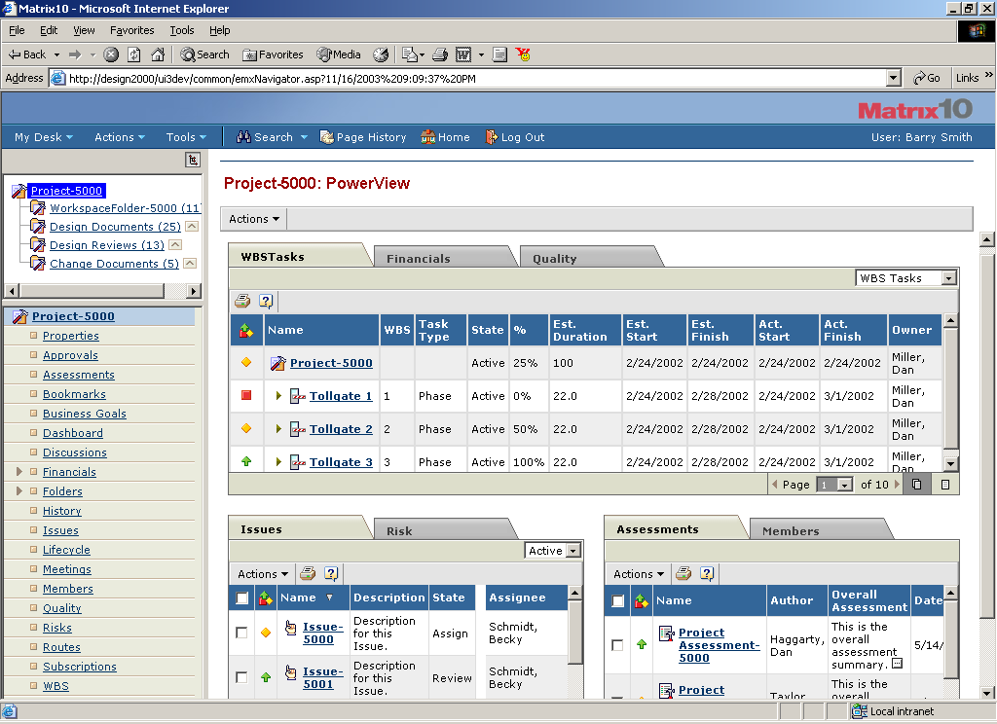
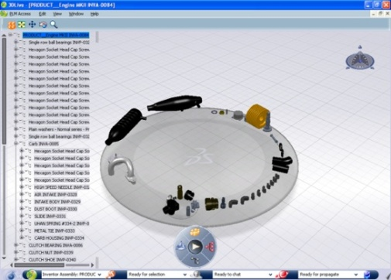
Governance
Portfolio Configuration Management
ENOVIA Variant Configuration Central provides a standard product structure to optimize the design process for new product concepts
Requirements Management
ENOVIA Requirements Central captures the voice of the customer and provides traceability to downstream design data
Program Management
ENOVIA Program Central manage complex programs across the extended enterprise with real-time access to development IP
Decision Support Business Intel
ENOVIA 3DLive is used to search, navigate, work, and collaborate in real-time with intuitive 3D data
Compliancy
ENOVIA Materials Compliance Central enables adherence to new environmental compliance regulations
Notes:
EACC2008 Orlando, FL
May 6-9, 2008
7

Slide 8

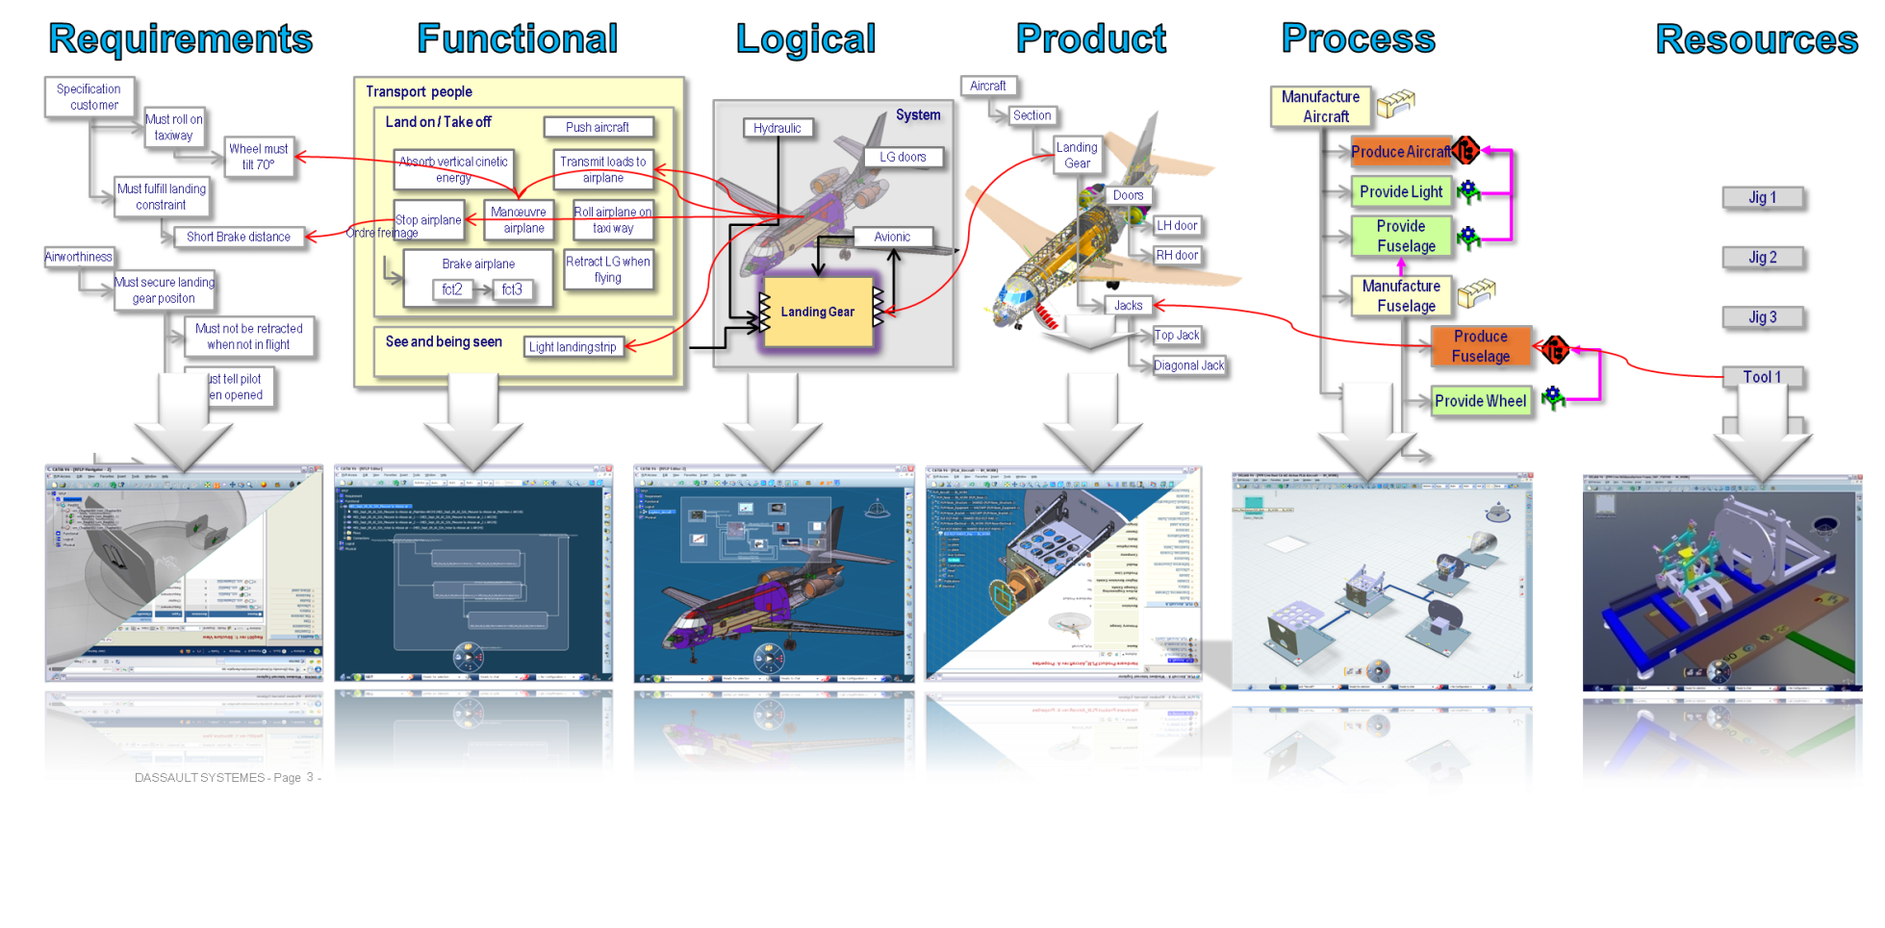
V6 Leverages Requirements Management
ENOVIA Requirement Central to capture customer or regulatory requests…
… empowered by V6 Collaborative environment
Requirements directly accessible and usable for all users
Full traceability / requirement change impact analysis along all product lifecycle
ENOVIA Requirements Central captures the voice of the customer and provides traceability to downstream design data
Notes:
Our view of collaborative Eng is that any engineers must be able to see and design in context of the configured digital mockup. The concept of engineering hub and manufacturing hub is not only to be the single reference for product/process and resource data, it contains as well the relationship between system so that an engineer can understand the impact of a given change.
The Engineering hub is accessible through a navigator, ingle desktop to remove non-value added task or interface.
The lifecycle hub provide common services to both eng and man hub for eng change management, configuration, …

Slide 9

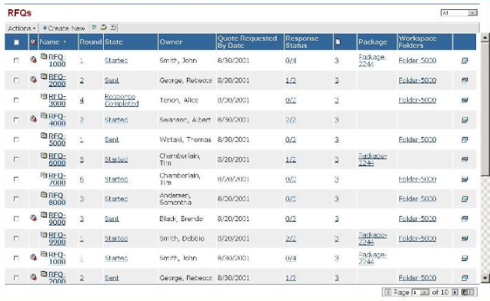
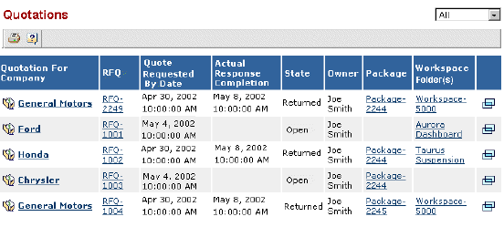
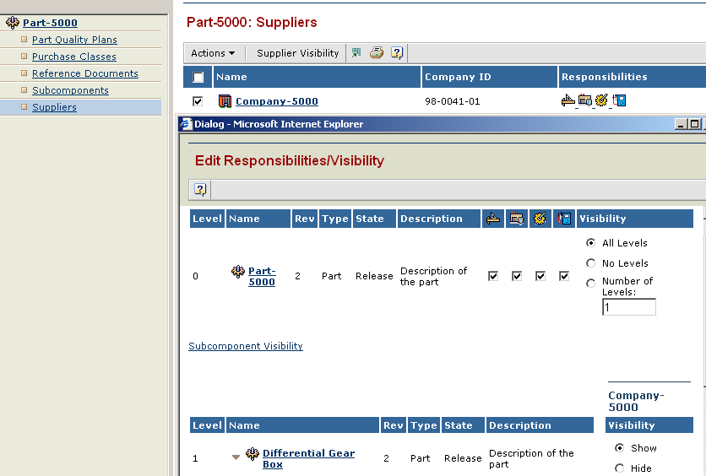
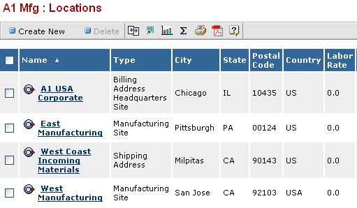
Global Sourcing
Collaborative Sourcing
ENOVIA Sourcing Central manages negotiations and quotes for procured products and services
ENOVIA Quotation Central leverages supplier expertise and ensures accurate and timely responses to new sourcing opportunities
Supplier Performance Monitoring
ENOVIA Supplier Central manages outsourced design and manufacturing partners to become an integral part of the design collaboration process
Supply Chain Network
ENOVIA Live Collaboration manages the supply chain’s contacts, locations, etc.
Notes:
EACC2008 Orlando, FL
May 6-9, 2008
9

Slide 10

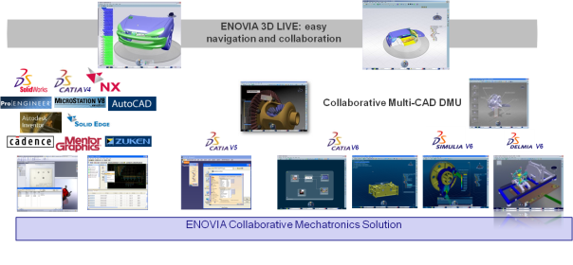
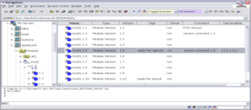
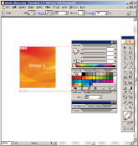
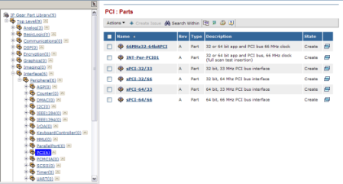
IP Lifecycle Management
IP Work-in-Progress
ENOVIA Synchronicity DesignSync Central manages semiconductor EDA and embedded software
ENOVIA Collaboration for Adobe Illustrator manages the creative artwork design process
IP Asset Release
ENOVIA Engineering Central manages the enterprise engineering bill-of-material and release processes to support “design anywhere build anywhere”
ENOVIA Specification Central standardizes product specifications such as packaging, raw materials and formulas
IP Classification & Reuse
ENOVIA Library Central manages company-specific library taxonomies for parts, documents and other product data classification
Notes:
EACC2008 Orlando, FL
May 6-9, 2008
10

Slide 11

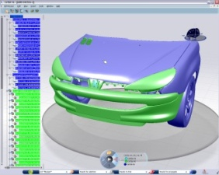
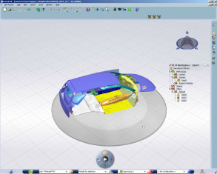



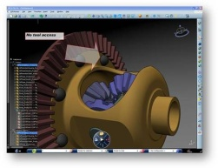
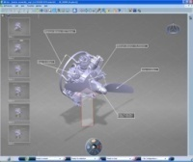
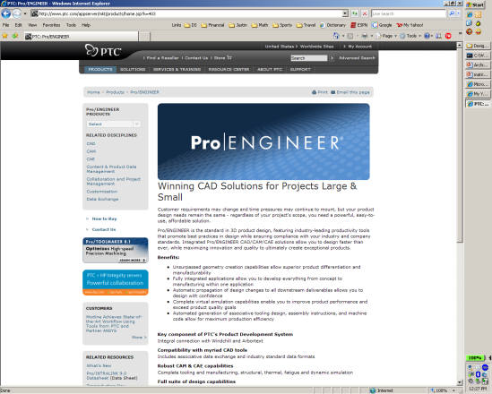
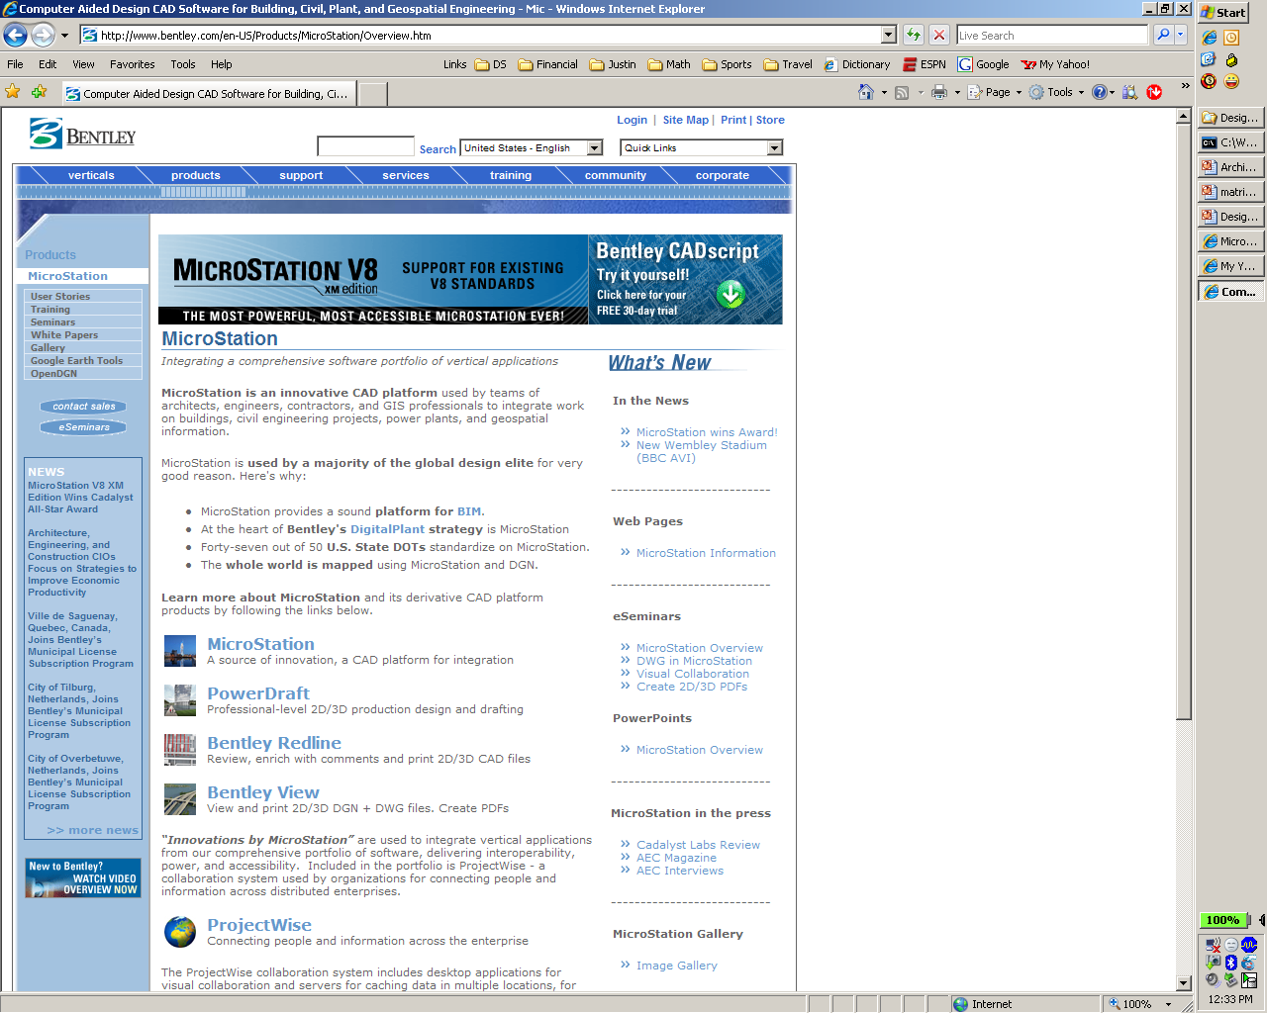

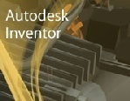






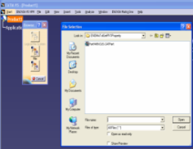
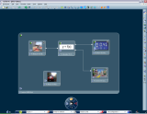
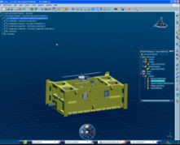
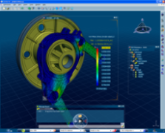
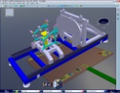
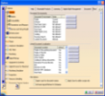
IPLifecycleManagement – IPWorkInProgress
ENOVIA 3D LIVE: easy navigation and collaboration
V4
Collaborative Multi-CAD DMU
V5
V6
V6
V6
ENOVIA Collaborative Mechatronics Solution
Design data management for most non-DS MCAD and ECAD tools
CATIA V4 / CATIA V5 management
Immersive CATIA / DELMIA / SIMULIA V6 management
Virtual product management
Intense concurrent engineering
Design in configured environment
DASSAULT SYSTEMES Confidential Secured Information – Internal usage only - Do not forward nor copy - Page -
Notes:
CATIA V6, … are also Multi-CAD - => si vous faites du multi-CAD il sera disponible ds CATIA
DMU to be positioned in the CATIA, … Space => DMU is the V6 Collabenv
3D Live should be above (easy access, nav, coll on 3D Content
Need to rework the description for the V6 part
All this available on-line through an internet cnx (key value)
Need to convey the imbedded value of VPM/DMU for the V6 env

Slide 12
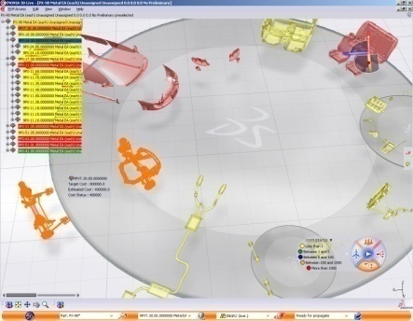
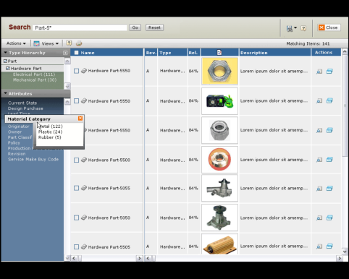
IP Management
Turn Collective Digital IP Asset into Profitable Innovation
3DLIVE
Dynamic Search
Search & navigation built-in
Use Case
Business Process
Decision Support
Understands PLM context from all data sources
Search Services
Structured Search
Directed Navigation
Keyword Search
Administration & Security
Index structured and unstructured information
IP Data Model
Structured 3D Index
Classification
Taxonomy
Keyword Index
Adaplet
Structured
Unstructured
Out-of-the box connectors
Connectors
Notes:
Why DS uniquely position:
IP Awareness- Understanding the PLM context across all data sources
Leading-edge search and navigation technologies built-in not bolted-on
Scalable SOA infrastructure
Unique ability to index structured and unstructured information / ready-to-use connectors
12

Slide 13
Unified collaboration - Value
Deploy product development processes across the extended enterprise
Aggregates IP across all business process domains into a single meta-model
Users across the extended enterprise can easily and quickly find product IP based on key words and file content regardless of how it was originally created
Enables collaboration involving stakeholders across product development and identify where the business process needs to be modified to eliminate bottlenecks
Leverages product information from other enterprise systems by federating their IP into the context of product development business processes
Provides the administrative tools to manage and deploy the ENOVIA system
Flexible tools that lower total cost of ownership while fulfilling unique business needs
Notes:
EACC2008 Orlando, FL
May 6-9, 2008
13

Slide 14
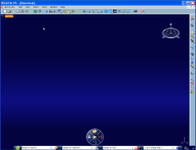
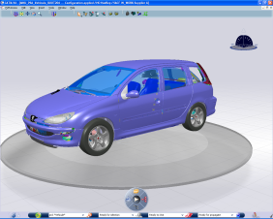
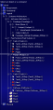
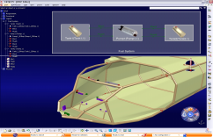
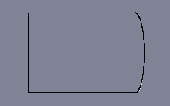

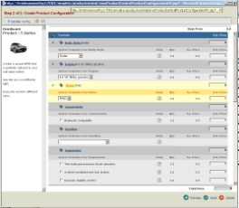
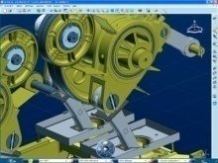
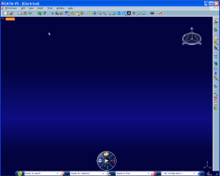
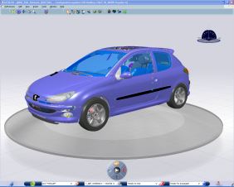













Multi discipline Collaborative Environment for CATIA/DELMIA/SIMULIA
From Requirement to Functional, Logical, Physical Product Definition and Simulation
Design in Configured Environment – Single Configuration definition
Concurrent Engineering – Manufacturing Definition
Multi-Discipline Collaboration – Intense on line Concurrent Engineering
Dassault Systemes Confidential Information

Slide 15



Multi-CAD Collaboration
Provide work-in-process data management across all popular mechanical and electrical CAD tools
Supported MCAD Adapters:
Supported ECAD Adapters:
Support for CATIA V6 – CATIA V5 Coexistence
Complete collaboration with V6 applications
Multi-CAD 3D Live Navigation
Composite EBOM
Digital Review and Synthesis

Slide 16
V6 PLM Extensibility Model
Create or Customize Connectors
Customize PLM SOA User Experience
Create or Customize PLM Business Processes
Create or Customize Data and UI Models
Create or Customize Business Logic, and IP Modelers

Slide 17



Integrating V6 with External Systems
Leveraging V6 Unified Live Collaboration backbone to connect V6 with xPDM/ERP/CRM/etc systems
Desktop
Enterprise
Use Cases
Authoring Application Integration
Heterogeneous Collaborative Design & Engineering
IP Digital Asset Management
Desktop Application
xPDM Orchestration
IP Federation
Connectors

Slide 18

Integrating V6 with External Systems
IP Federation: Master Data focus
Enables access and consume in V6 information stored in various enterprise systems (ERP, PDM, etc.) as if these data were in V6
Single logical database, “single version of the truth”
Real-time
Without replicating data in V6
Without modifying data in target system
xPDM Orchestration: Process Focus
Set up a formal process between different PLM systems to allow information exchange and synchronization
Bi-directional
Asynchronous
Partial data are replicated in systems:
Replicated data can be alternatively authored in both systems with enforced control
Fully automatic, no user or admin required in replication/synchronization
no more issue of reconciliation
V6
xxx
xxx
xxx
Real-time
V6
xxx
Asynchronous

Slide 19

V6 Federation Technologies
Adaplet
Extends persistence layer
Query/Expand
Metadata Read/Write
File Read/Write
‘Proxy’ object
Schema mapping split between persistence and federation layers
Web Services
Integration of heterogeneous systems
Loosely coupled services through middleware
Standards-based integration development
Adaplet
Session Mgr
Cache Mgr
Schema Manager
Java/C++
Web Service
WSDL
Notes:
Application Integration and Data Transport

Slide 20



Slide 21




V6 Centralized Architecture with Distributed Stores
Central Metadata for Concurrent Engineering
Full HTTP architecture
F
D
A
F
F
A: ENOVIA Application Server (MCS)
D: Database Server (DB)
F: ENOVIA File Server (FCS)
F
Web clients re-direct to most appropriate file server to eliminate file transfer across WAN
File Collaboration Server distributed to be close for editing PLM objects
Seamless File management and Synchronization maintains data integrity across sites
Notes:
21
21
This architecture keeps the central database, but it distributes the file servers to handle check-in and check-out of files on remote sites. The FCS from ENOVIA allows the web clients to access the central DB for all metadata requests. The requests are then redirected to the local file server to perform check-in and check-out operations on the physical files.
[NOTE: This needs to be more clearly explained to IDSICC by Dassault]
Even though a single schema is used, there is no reason that this schema can not manage site-specific business rules if necessary. ENOVIA has several business modeling services that can accommodate these differences – particularly with the addition of Multiple Access Delegation and Expression Access.

Slide 22

V6 PCS built in Network breakthrough
V6 is designed to work over the WAN
V6 Service oriented protocol without chat
Message compression
Distributed FCS & cache mechanisms
Limited Wan overhead even with poor latency (250 ms)
impact of the wan for metadata
< 30%

Slide 23
Extended Enterprise and Supplier Collaboration

Slide 24



V6 Enterprise-Ready Architecture
Massively Scalable Server
Built on proven, robust, scalable architecture to meet the demands of the largest enterprises
10’s of thousands of Concurrent Users in Production on MatrixOne today
Terabytes of Data
High Performance Distributed File Stores
Local File Stores for High Performance
Seamless File Management, Replication, and Synchronization maintains data integrity across sites
Centralized Meta-Data for Concurrent Engineering

Slide 25

V6 Architecture Key Highlights & Benefits
Single multi-tiered architecture supports PLM for global enterprises
Unified administration and P&O reduce Total-Cost-of-Ownership (TCO)
Centralized database architecture simplifies solution implementation and propagation of customization changes
Distributed file stores technology provides critical multi-site implementation flexibility and optimized network performance
Web access (WAN) leverages light clients usage for efficientonline access & information sharing between creators, the ecosystem and consumers.
Architecture scalability enables to support a large range of implementations from small to large deployment
Flexible, open SOA infrastructure allows rapid adoption and choice of new technologies
Security technology secured access and exchange of information
Principle of 3 Tier Architecture

Slide 26
Thank you

